Slide 1

2020
EZStation Access Control
Feature Introduction
[V.202004]

Slide 2
Feature Overview
Module | Item
Device management | Connect and manage access control devices(Filter devices, sync time, go to Web interface)
Client configuration | Mask detection, abnormal temperature detection configuration
Access control | Face library management Add/delete/edit face library Add person info in batches or by importing file; delete/edit person info Import/export person information, download template Search person info by name or ID No.
 | Realtime monitoring Live view, open door remotely, realtime pass-thru records
 | Entry/exit records Search records by set condition, export records, view original snapshot
Remarks | Face image requirement 10KB~500KB; JPG format; within 1080P

Slide 3
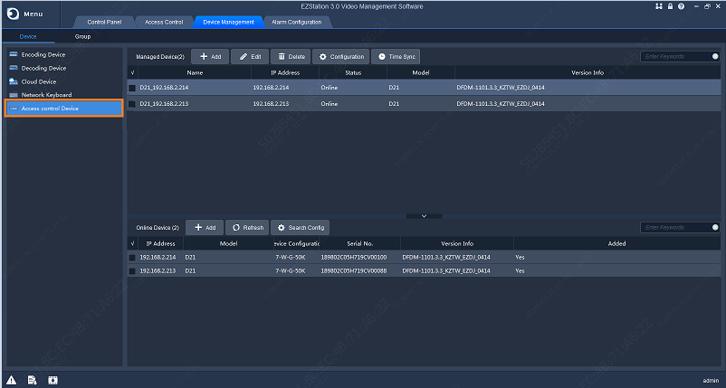
Device Management-Access Control Devices
【Access control device management】
Add/edit/configure/delete devices, access the Web page, sync device time
Search and add online devices

Slide 4
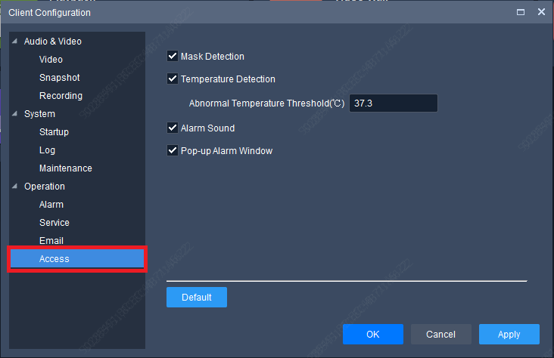
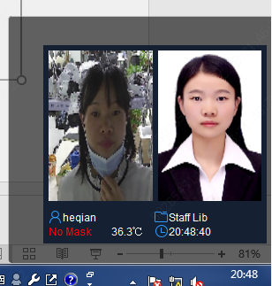
Client Configuration
Enable mask detection
Enable temperature detection, set abnormal temperature threshold
Enable alarm sound
Enable pop-up alarm window
Pop-up window details:
【 Alarm Configuration】
Name, face library, mask status, temperature and time are displayed in real time
Notes:
异常温度阈值范围：30~45℃

Slide 5
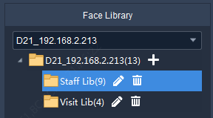
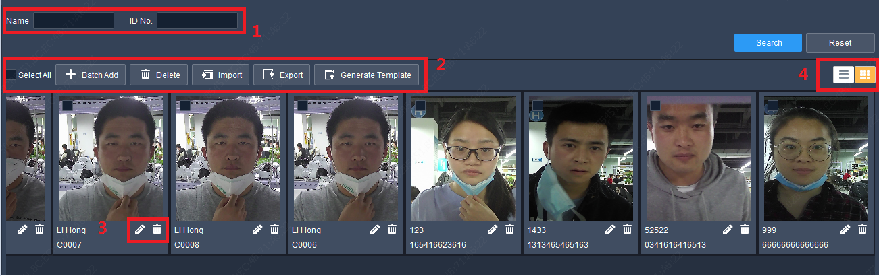
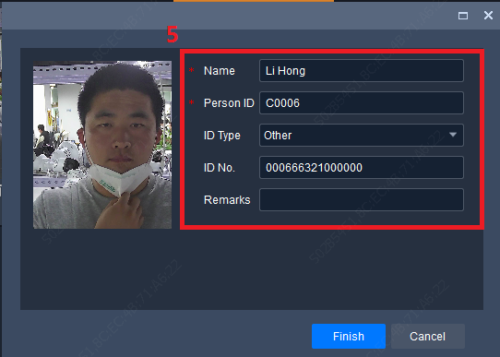
Access Control-Face Library Management
【Face library management】 Up to 16 face libraries are supported for one access control device
Face library
Person info
1、Select device
2、Click“+”to add face library
3、Support editing face library
4、 Support deleting face library
1、Search person by name, ID No.
2、 Add person info in batches or by importing file; Import/export person information, download template
3、Edit/ delete person info
4、Person info display mode: List or Image
5、Person info includes: name, person ID, ID type, ID No., remarks

Slide 6
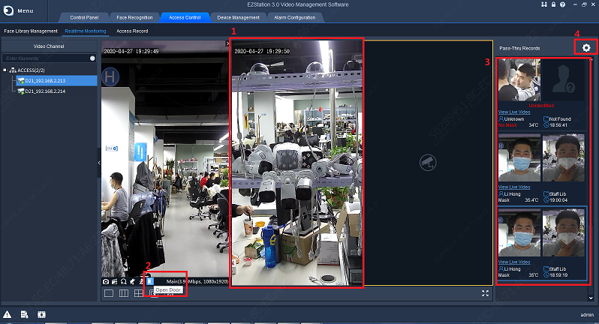

Access Control-Realtime Monitoring
1.Live view Up to 4 simultaneous live videos
4.Configurations Open client configuration window
3. Entry/exit records
Double-click to view person info and original snapshot
Add stranger to face library
Up to 10 snapshots displayed
Shows name, face library, mask status, temperature and time
2. Open door Open door remotely
Notes:
注：上报的记录为当前播放实况的出入记录。

Slide 7
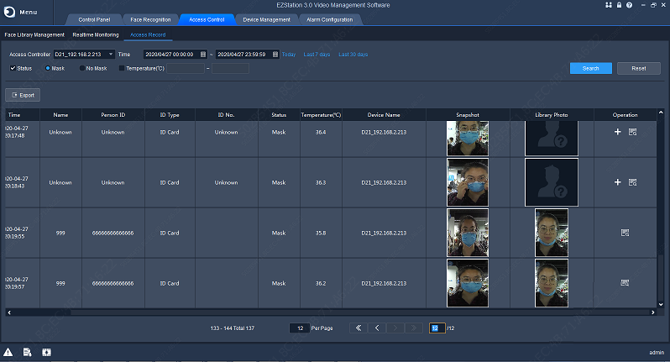
Access Control-Entry/Exit Records
【Entry/exit records】
Search pass-thru records of specified device by time, mask status, temperature range
Add stranger to face library, view original snapshot
Export records

Slide 8

守护安全美好生活
/*摩洛哥港市拉腊什，大西洋海鸥*/

